Slide 1
OPERATING SYSTEMS
PROCESS SYNCHRONIZATION

Slide 2
Introduction
On the basis of synchronization, processes are categorized as one of the following two types:
Independent Process : Execution of one process does not affects the execution of other processes.
Cooperative Process : Execution of one process affects the execution of other processes.
Process synchronization problem arises in the case of Cooperative process also because resources are shared in Cooperative processes.

Slide 3
The Producer Consumer Problem
PROCESS SYNCHRONIZATION
A producer process "produces" information "consumed" by a consumer process. Here are the variables needed to define the problem:
#define BUFFER_SIZE 10
typedef struct {
DATA data;
} item;
item buffer[BUFFER_SIZE];
int in = 0; // Location of next input to buffer int out = 0; // Location of next removal from buffer int counter = 0; // Number of buffers currently full
Consider the code segments on the next page:
Does it work?
Are all buffers utilized?

Slide 4
The Producer Consumer Problem
PROCESS SYNCHRONIZATION
A producer process "produces" information "consumed" by a consumer process.
#define BUFFER_SIZE 10
typedef struct { DATA data;
} item;
item buffer[BUFFER_SIZE]; int in = 0;
int out = 0;
int counter = 0;
item nextProduced;
PRODUCER
while (TRUE) {
while (counter == BUFFER_SIZE); buffer[in] = nextProduced;
in = (in + 1) % BUFFER_SIZE;
counter++;
}
item nextConsumed;
CONSUMER
while (TRUE) {
while (counter == 0); nextConsumed = buffer[out];
out = (out + 1) % BUFFER_SIZE;
counter--;
}
producer
consumer

Slide 5
The Producer Consumer Problem
PROCESS SYNCHRONIZATION
Note that counter++; 🡪 this line is NOT what it seems!!
is really -->
register = counter register = register + 1 counter = register
At a micro level, the following scenario could occur using this code:
TO; | Producer | Execute | register1 = counter | register1 = 5
T1; | Producer | Execute | register1 = register1 + 1 | register1 = 6
T2; | Consumer | Execute | register2 = counter | register2 = 5
T3; | Consumer | Execute | register2 = register2 - 1 | register2 = 4
T4; | Producer | Execute | counter = register1 | counter = 6
T5; | Consumer | Execute | counter = register2 | counter = 4

Slide 6
PROCESS SYNCHRONIZATION
Critical Sections
A section of code, common to n cooperating processes, in which the
processes may be accessing common variables.
A Critical Section Environment contains:
Entry Section: Code requesting entry into the critical section.
Critical Section Code in which only one process can execute at any one time.
Exit Section The end of the critical section, releasing or allowing others in.
Remainder Section Rest of the code AFTER the critical section.

Slide 7
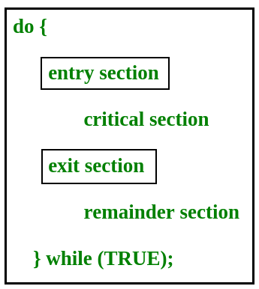
In the entry section, the process requests for entry in the Critical Section.

Slide 8
Solution to Critical-Section Problem
1. Mutual Exclusion - If process P_{i} is executing in its critical section, then no other processes can be executing in their critical sections
2. Progress - If no process is executing in its critical section and there exist some processes that wish to enter their critical section, then the selection of the processes that will enter the critical section next cannot be postponed indefinitely
3. Bounded Waiting - A bound must exist on the number of times that other processes are allowed to enter their critical sections after a process has made a request to enter its critical section and before that request is granted
Assume that each process executes at a nonzero speed
No assumption concerning relative speed of the n processes

Slide 9
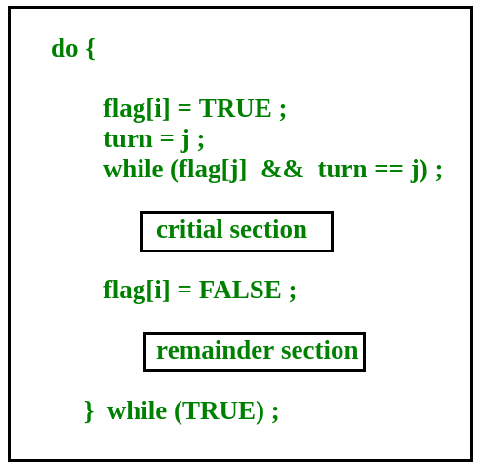
Peterson solution
Peterson’s Solution
Peterson’s Solution is a classical software based solution to the critical section problem.
In Peterson’s solution, we have two shared variables:
boolean flag[i] :Initialized to FALSE, initially no one is interested in entering the critical section
int turn : The process whose turn is to enter the critical section.

Slide 10
Peterson’s Solution preserves all three conditions :
Mutual Exclusion is assured as only one process can access the critical section at any time.
Progress is also assured, as a process outside the critical section does not block other processes from entering the critical section.
Bounded Waiting is preserved as every process gets a fair chance. Disadvantages of Peterson’s Solution
It involves Busy waiting
It is limited to 2 processes.

Slide 11
Synchronization Hardware
There are three algorithms in the hardware approach of solving Process Synchronization problem:
Test and Set
Swap
Unlock and Lock

Slide 12
Test and set
1. Test and Set :
A hardware solution to the synchronization problem
there is a shared lock variable which can either take one value 0 or 1
Before enter in critical section ,process inquiry about the lock

Slide 13
TestAndSet Instruction
Definition:
boolean TestAndSet (boolean *target)
{
boolean rv = *target;
*target = TRUE;
return rv:
}
The definition of the TestAndSet () instruction.

Slide 14
Solution using TestAndSet
Shared boolean variable lock, initialized to FALSE
Solution:
do {
while ( TestAndSet (&lock )); // do nothing
// critical section
lock = FALSE;
// remainder section
} while (TRUE);

Slide 15
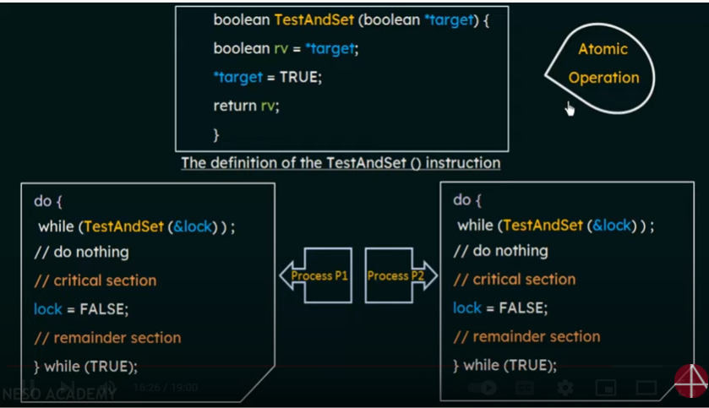

Slide 16
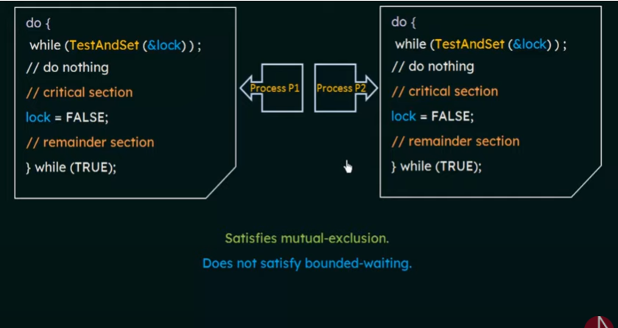

Slide 17
Here, the shared variable is lock which is initialized to false.
TestAndSet(lock) algorithm works in this way – it always returns whatever value is sent to it and sets lock to true.
The first process will enter the critical section at once as TestAndSet(lock) will return false and it’ll break out of the while loop.
The other processes cannot enter now as lock is set to true and so the while loop continues to be true.
Mutual exclusion is ensured.
Once the first process gets out of the critical section, lock is changed to false. So, now the other processes can enter one by one. Progress is also ensured.
However, after the first process any process can go in. There is no queue maintained, so any new process that finds the lock to be false again, can enter. So bounded waiting is not ensured.

Slide 18
Swap Instruction
Definition:
void Swap (boolean *a, boolean *b)
{
boolean temp = *a;
*a = *b;
*b = temp:
}

Slide 19
Solution using Swap
Shared Boolean variable lock initialized to FALSE; Each process has a local Boolean variable key
Solution:
do {
key = TRUE;
while ( key == TRUE)
Swap (&lock, &key );
// critical section
lock = FALSE;
// remainder section
} while (TRUE);

Slide 20
PROCESS SYNCHRONIZATION
Monitors
High-level synchronization construct that allows the safe sharing of an abstract data type among concurrent processes.
monitor monitor-name
{
shared variable declarations
procedure body P1 (…) {
. . .
}
procedure body P2 (…) {
. . .
}
procedure body Pn (…) {
. . .
}
{
initialization code
}
}
6: Process Synchronization
34

Slide 21
PROCESS SYNCHRONIZATION
Monitors
To allow a process to wait within the monitor, a condition variable must be declared, as
condition x, y;
Condition variable can only be used with the operations wait and
signal.
The operation
x.wait();
means that the process invoking this operation is suspended until another process invokes
x.signal();
The x.signal operation resumes exactly one suspended process. If no process is suspended, then the signal operation has no effect.

Slide 22
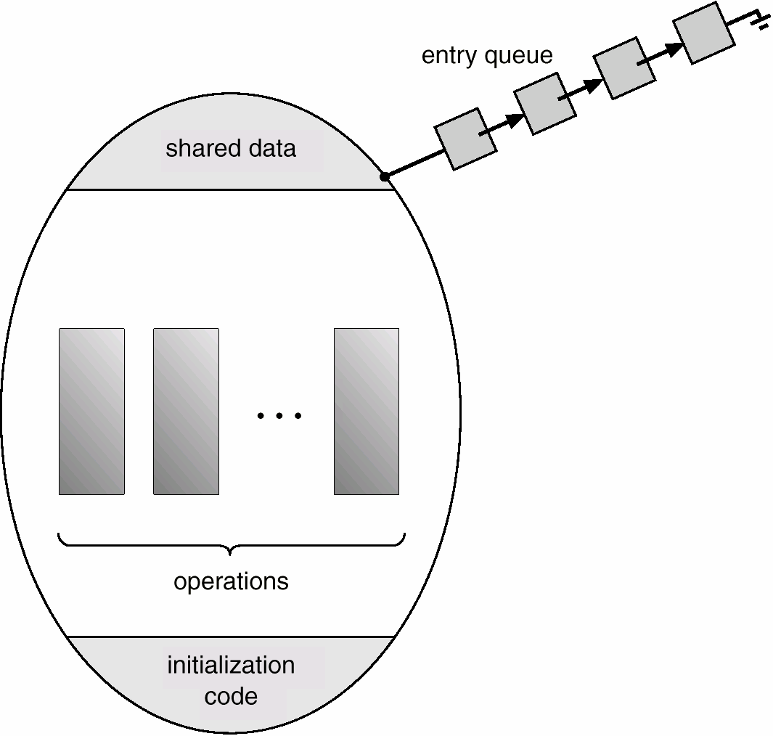
PROCESS SYNCHRONIZATION
Monitors
Schematic View of a Monitor

Slide 23
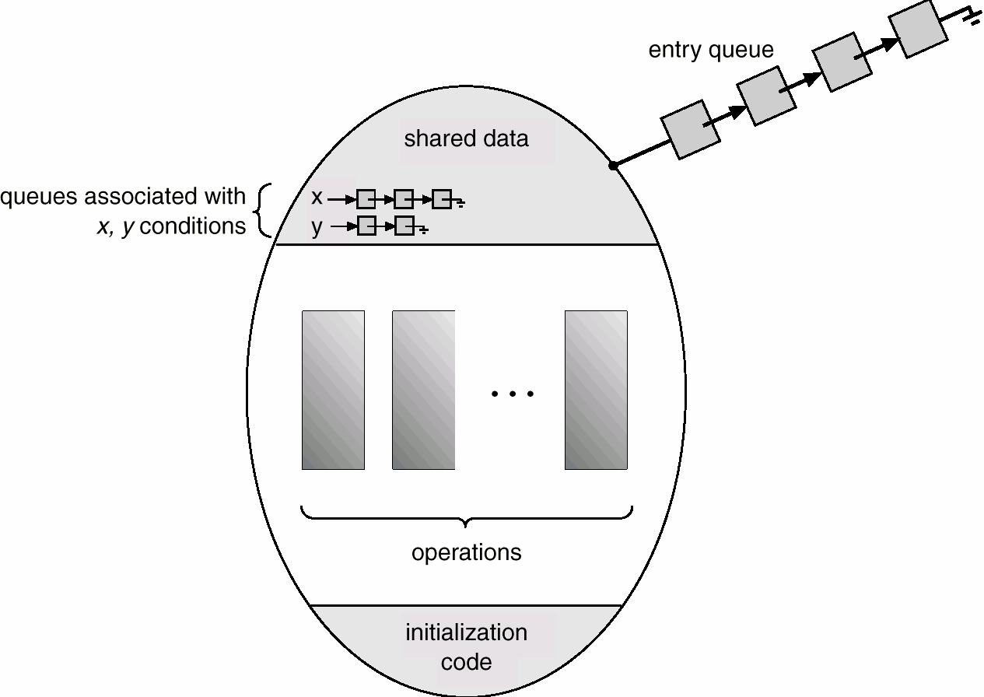
PROCESS SYNCHRONIZATION
Monitors
Monitor With Condition Variables

Slide 24
PROCESS SYNCHRONIZATION
Monitors Dining Philosophers
Example
monitor dp {
enum {thinking, hungry, eating} state[5]; condition self[5];
}
void putdown(int i) { state[i] = thinking;
// test left & right neighbors test((i+4) % 5);
test((i+1) % 5);
}
initializationCode() {
for ( int i = 0; i < 5; i++ ) state[i] = thinking;
}
void test(int i) {
if ( (state[(I + 4) % 5] != eating) && (state[i] == hungry) && (state[(i + 1) % 5] != eating)) {
state[i] = eating; self[i].signal();
}
}
void pickup(int i) { state[i] = hungry; test[i];
if (state[i] != eating)
self[i].wait();
}

Slide 25
PROCESS SYNCHRONIZATION
How Is This Really Used?
Windows XP Synchronization
Uses interrupt masks to protect access to global resources on uniprocessor systems.
Uses spinlocks on multiprocessor systems.
Also provides dispatcher objects which may act as either mutexes or semaphores.
Dispatcher objects may also provide events. An event acts much like a condition variable.

